Slide 1

Architectural Activities &
Design Process
Software Architecture
3rd Year – Semester 1
Lecture 4

Slide 2
Architectural Process & the ABC
What activities are involved in creating a Software Architecture?
Using the selected Architecture how to realize a Design and then Implement or Manage the Evolution of a target system or application?

Slide 3
Where do Architectures come from?
An architecture is the result of a set of business and technical decisions
Influenced by:
  Stakeholders
    Management: Low Cost | Marketing: Time to Market | End User: UX, Security
  Developing Organization
    Investments already made | Future Investments | Organizational Structure
  Experience & Background of the Architect(s)
    Technical Skills | Domain Knowledge
  Technical Environment
    Software Engineering Techniques, practices & processes
Notes:
Developing Organization:
Investments already made: The Team may be already invested on certain technologies and expertise
Future Investments: The Organization may be planning to make future investments (i.e. infrastructure) as a part of the new Architecture
Organizational Structure: Using internal teams or even subcontracting certain areas to specialized teams

Slide 4
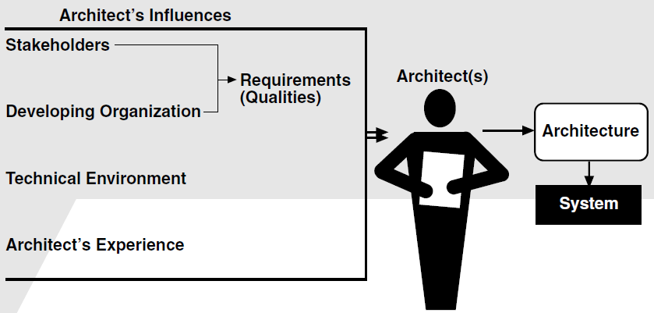
Architect’s Influence
Notes:
Output: Architecture that leads to the System Development

Slide 5
Architecture Business Cycle (ABC)
Software architecture is a result of technical, business, and social influences.
Its existence in turn affects the technical, business, and social environments that subsequently influence future architectures.
We call this cycle of influences, from the environment to the architecture and back to the environment, the Architecture Business Cycle (ABC)

Slide 6
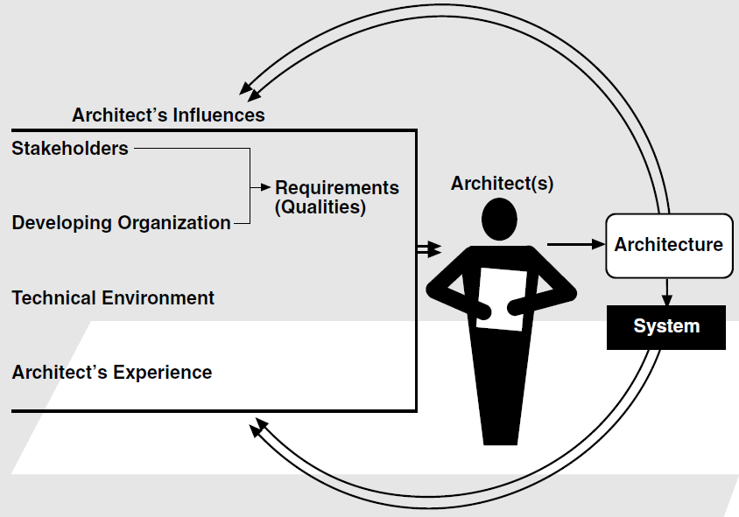
The Architecture Business Cycle

Slide 7
Ramifications of Architecture
Affects the structure of the developing organization
  Team Structure, Specialized Skills for Teams, etc.
Affects the Goals of development organization
  The organization may adjust its goals depending on the result of the current system to explore the future markets
Affects future customer requirements
Affects the Architect
  Architect also will gain more experience based on the results
Affects the Development Process & Culture
Notes:
Consequences / Results of Architecture

Slide 8
Architectural Activities
Creating the Business Case for the System
Understanding the Requirements
Creating or Selecting the Architecture
Documenting and Communicating the Architecture
Analyzing or Evaluating the Architecture
Implementing the system based on the Architecture
Ensuring that the implementation Conforms to the Architecture

Slide 9
Creating the Business Case for the System
Assess the market need for a system
How much should the product cost?
What is its targeted market?
What is its targeted time to market?
Will it need to interface with other systems?
Are there system limitations that it must work within?
Note: Above cannot be decided solely by an architect, but if an architect is not consulted in the creation of the business case, it may be impossible to achieve the business goals!

Slide 10
Understanding the Requirements
Various methods exists for capturing functional requirements;
  OOAD uses Scenarios or Use Cases
  Safety Critical Systems uses Finite-state-machine models or Formal specification language
For Non-Functional requirements;
  Quality Attribute Scenarios
Prototyping
Domain Modeling

Slide 11
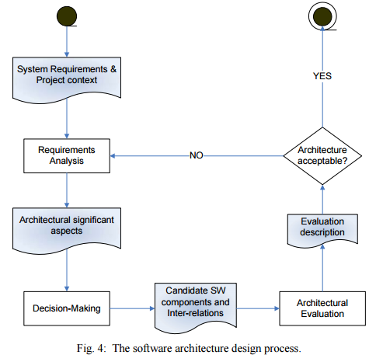
Creating or Selecting the Architecture
The process of how to create an architecture to achieve its behavioral and quality requirements

Slide 12
Documenting and Communicating the Architecture
For the architecture to be effective as the backbone of the project's design, it must be communicated clearly and unambiguously to all of the stakeholders
  Developers: must understand the work assignments it requires of them
  Testers: must understand the task structure it imposes on them
  Management: must understand the scheduling implications it suggests
Architectural documentation should be informative, unambiguous, and readable by many people with varied backgrounds

Slide 13
Analyzing or Evaluating the Architecture
In any design process there will be multiple candidate designs considered, some will be rejected immediately and others will contend for primacy
Choosing among these competing designs in a rational way is one of the architect's greatest challenges
Methods:
  Architecture Tradeoff Analysis Method (ATAM) is the most mature methodology
  Cost Benefit Analysis Method (CBAM) focuses more on economic implications of architectural decisions

Slide 14
Implementing the system based on the Architecture
Ensure the developers are kept faithful to the structures and interaction protocols constrained by the architecture
The Environment should assists developers in creating and maintaining the architecture
Architect’s involvements:
  Technology & Technical Infrastructure Selection & Setup
  Setting up Appropriate Software Engineering Processes
  Creating the Team
    Identify Technical specialists
    Identify Skill Gaps and mitigate (trainings, etc.)

Slide 15
Ensuring that the implementation Conforms to the Architecture
Constant vigilance is required to ensure that the actual architecture and its representation remain faithful to each other in the maintenance phase
Notes:
Implementation of the system to the Clients (not the development of the system)

Slide 16
What makes a Good Architecture?
No such thing as an inherently good or bad architecture
Architectures are more or less fit for some stated purpose
Architectures can be evaluated
  One of the great benefits of paying attention to them
  Should be evaluated only in the context of specific goals
Rules of Thumb (from knowledge & experience):
  Process Recommendations:
    Functional Requirements & identifying Quality Attributes which are of high priority
    Analyze & formally evaluate before it is too late to change
  Product Recommendations:
    Software Principles e.g. Information hiding, Separation of concerns
    Write tasks or processes to allow easy reallocation, perhaps at runtime

Slide 17
Architectural Design Process
Objectives of the Design Process:
  Creativity
    Enhance your skillset
    Provide new tools
  Method
    Focus on highly effective techniques
  Develop judgment: when to develop novel solutions, and when to follow established method

Slide 18
Engineering Design Process
Feasibility:
  Identifying a set of feasible concepts for the design as a whole
Preliminary design:
  Selection and development of the best concept
Detailed design:
  Development of engineering descriptions of the concept
Planning:
  Evaluating and altering the concept to suit the requirements of production, distribution, consumption and product retirement

Slide 19
Potential Problems
If the designer is unable to produce a set of feasible concepts, progress stops
As problems and products increase in size and complexity, the probability that any one individual can successfully perform the first steps decreases
The standard approach does not directly address the situation where system design is at stake, i.e. when relationship between a set of products is at issue
As complexity increases or the experience of the designer is not sufficient, alternative approaches to the design process must be adopted

Slide 20
Alternative Design Strategies
Standard
  Linear model
Cyclic
  Process can revert to an earlier stage
Parallel
  Independent alternatives are explored in parallel
Adaptive (“lay tracks as you go”)
  The next design strategy of the design activity is decided at the end of a given stage
Incremental
  Each stage of development is treated as a task of incrementally improving the existing design

Slide 21
Identifying a Viable Strategy
Use fundamental design tools: abstraction and modularity
  But how?
Inspiration, where inspiration is needed. Predictable techniques elsewhere.
  But where is creativity required?
Applying own experience or experience of others

Slide 22
Tools & Patterns of Software Engineering
Abstraction
  Abstraction(1): look at details, and abstract “up” to concepts
  Abstraction(2): choose concepts, then add detailed substructure, and move “down”
Separation of Concerns
Architectural Patterns & Styles
  Layered
  Model View Controller (MVC)
  Client-Server

Slide 23
Controlling the Design Strategy
Manage the Activity: Exploring diverse approaches to the problem demands that some care be used in managing the activity
Review: Identify and review critical decisions
Cost: Relate the costs of research and design to the penalty for taking wrong decisions
Enforce: Insulate uncertain decisions
Cross Check with Requirements: Continually re-evaluate system requirements in light of what the design exploration yields

Slide 24
Insights from Requirements
In many cases new architectures can be created based upon experience with and improvement to pre-existing architectures
Requirements can use a vocabulary of known architectural choices and therefore reflect experience
The interaction between past design and new requirements means that many critical decisions for a new design can be identified or made as a requirement

Slide 25
Insights from Implementation
Constraints on the implementation activity may help shape the design
Externally motivated constraints might dictate
  Use of a middleware
  Use of a particular programming language
  Software reuse
Design and implementation may proceed cooperatively
Initial partial implementation activities may yield critical performance or feasibility information

Slide 26
References
Software Architecture in Practice, 2nd Ed., by Len Bass, Paul Clements, Rick Kazman
http://www.ece.ubc.ca/~matei/EECE417/BASS/ch01.html
http://www.ics.uci.edu/~taylor/classes/211/DesignAndArchitecture.pdf

